Slide 1
The Pupil Safeguarding Review
Questions for trusts to discuss

Slide 2
Introduction
The Key and Edurio ran a survey in Autumn 2022 of almost 70,000 pupils in primary and secondary schools across England, to measure their feelings of safety in school, out of school and online.
The full report can be found here.
Use this deck of slides to support you as trust leaders to think through what the findings mean in your own primary and secondary school settings.
How to use this deck
You can use these slides as a trust leadership team, with your DSLs or with trustees. They’re designed to help you:
Reflect on your own safeguarding provision
Reflect on data capture and usage in relation to pupil safety
Initiate discussion about how to improve pupils’ feelings of safety in school
Discuss whether a trust-wide approach would be beneficial
In addition, there are 2 companion decks which can be used by school leaders and governors.

Slide 3
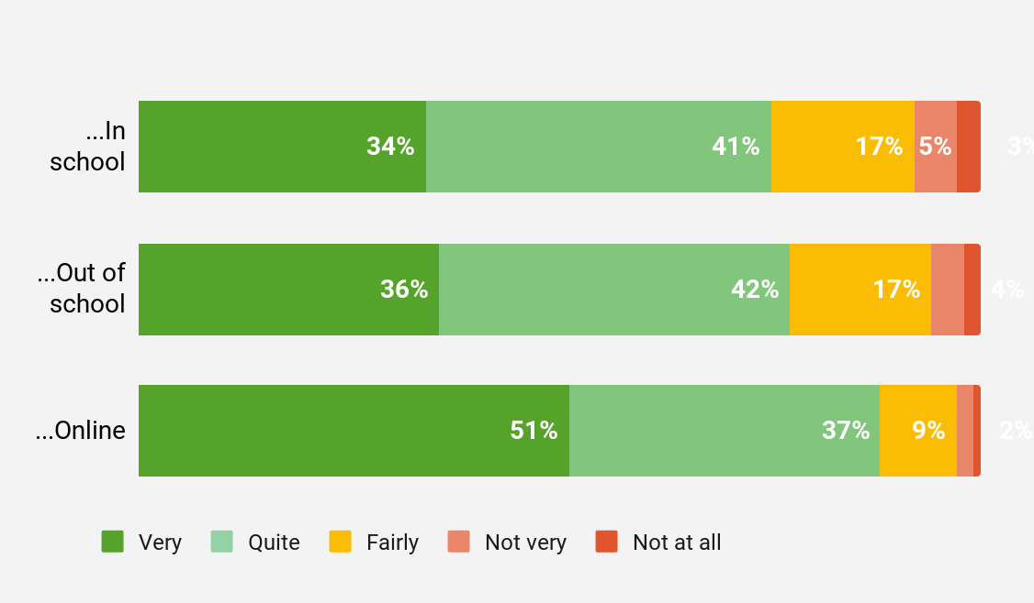
Feeling safe in and out of school, and online
What it shows:
A quarter of pupils report that they felt only fairly safe, not very or not at all safe, in school in the last 6 months. Safety scores for in school are slightly worse than out of school: 75% of pupils feel safe in school, while 78% of pupils feel safe out of school. Pupils feel safest online: here, 88% of pupils reported feeling safe. 8% of pupils reported feeling not very, or not at all, safe in school, compared to only 3% of pupils when online.
Questions to ask yourselves:
Why do we think pupils feel safer online than in school?
8% of pupils, on average, say they don’t feel safe in school. How true do you think that is for schools in our trust, and do we have a reliable way of measuring that?
Recently (in the last 6 months) how safe have you felt…?
Sample 68,214

Slide 4
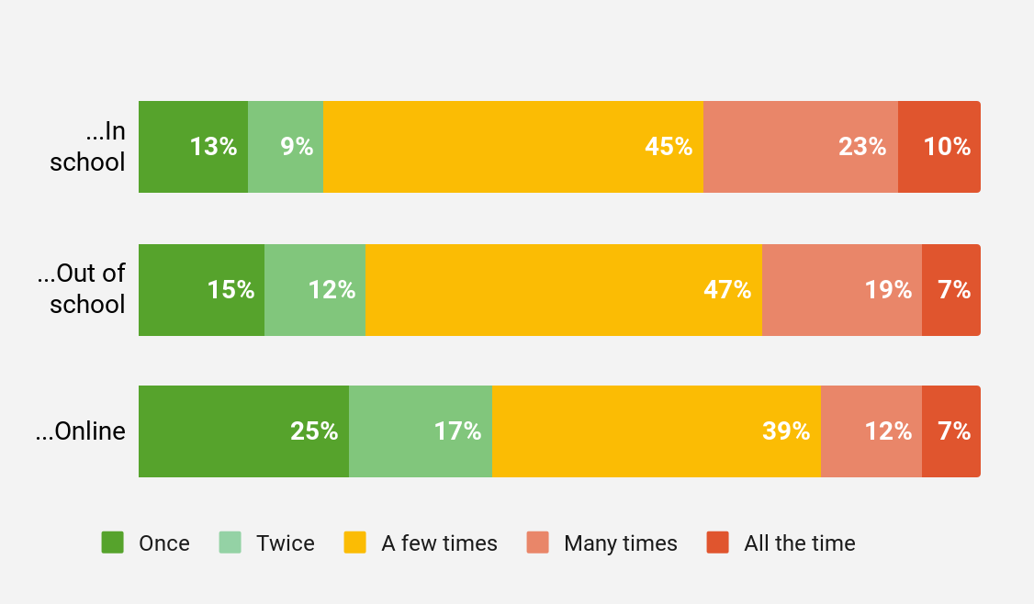
Frequency of feeling unsafe
What it shows:
Of the pupils who felt unsafe in school in the past 6 months, a third reported that they felt unsafe many times or all the time during that period. This frequency of many times or all the time feeling unsafe is true only for a quarter of those who felt unsafe out of school, and less than a fifth of pupils who felt unsafe online.
Questions to ask yourselves:
As a trust, how do we know when an issue with a pupil feeling unsafe has been resolved by the school and isn’t recurring?
How many times a year do we monitor feelings of pupil safety, and do we think this is adequate?
Recently (in the last 6 months) how many times have you felt unsafe…?
Sample 15,145

Slide 5
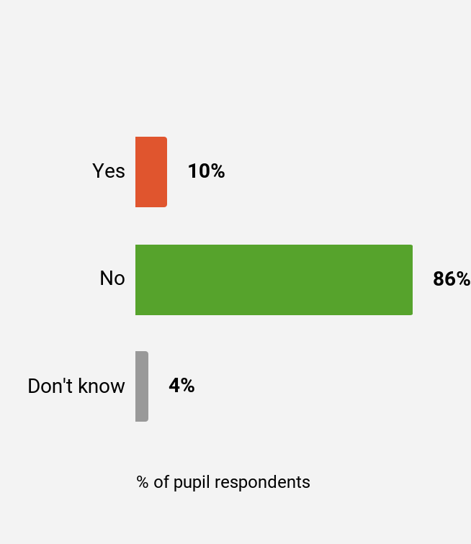
Missing school because of feeling unsafe
What it shows:
10% of pupils have missed school in the past 6 months because they felt unsafe, and a further 4% didn’t want to answer the question. In a class of 30 pupils, this could mean 2 to 4 of those pupils are missing school for safeguarding reasons.
Questions to ask yourselves:
How are our schools reliably identifying pupils who may have missed school because they don’t feel safe?
What processes are in places to support pupils returning to school after absence, and do these support our understanding of feelings of safety?
Is our trust collecting this information?
Recently (in the last 6 months) have you missed school because you felt unsafe? Overall
Sample 68,214

Slide 6
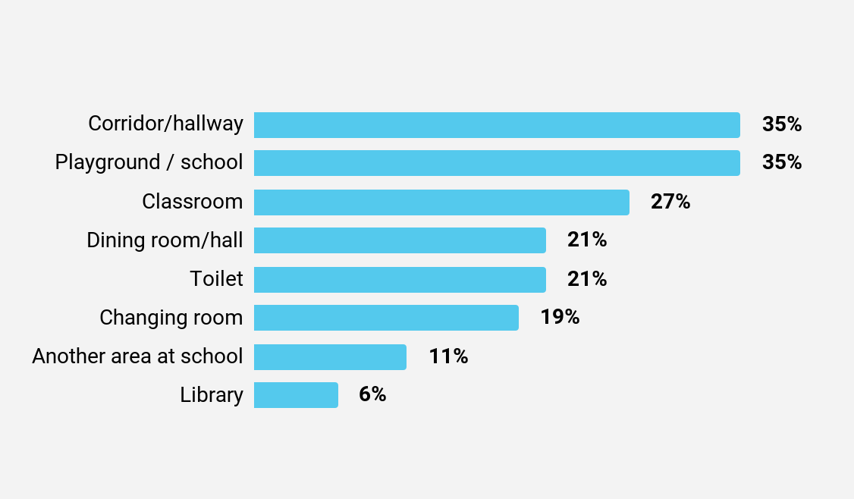
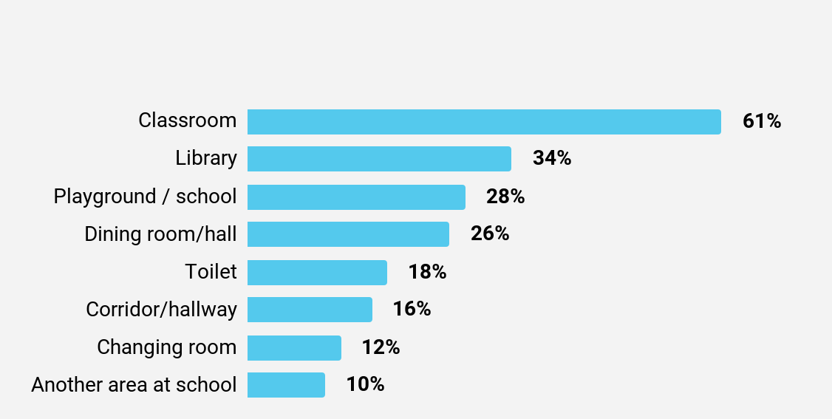
Where in school were you when you felt unsafe? Responses from pupils who felt fairly, not very, or not at all safe at school
Where is safe/unsafe?
What it shows:
The corridor and school grounds are the areas pupils are most likely to feel unsafe. While 27% of pupils reported that they were in the classroom when they felt unsafe, it’s also the area where most pupils who did feel safe, reported feeling safest. The library is also a safe space.
Questions to ask yourselves:
In our schools, which areas do we understand to be spaces which are relatively “safe” and “unsafe”? How do we know this?
Are there any common spaces across the trust which are considered unsafe, and how are we networking staff to address this?
Sample 15,145
In which place do you feel safest at school?
Responses from pupils who felt quite or very safe at school
Sample 44,358

Slide 7
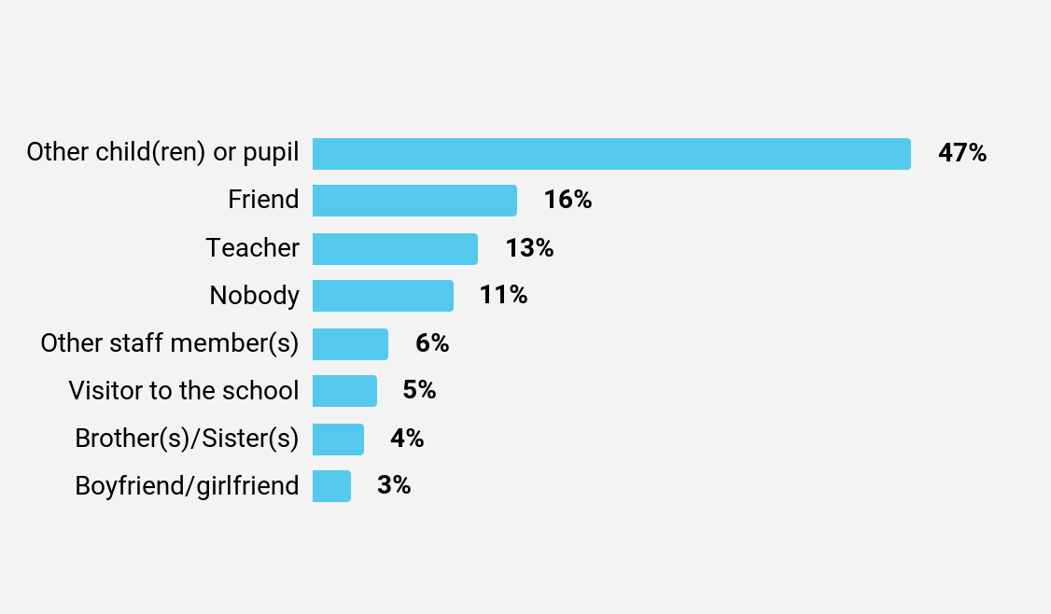
Who makes pupils feel unsafe?
What it shows:
In school, it’s mostly other children who made pupils who felt unsafe, feel that way: 47% of pupils who had felt unsafe reported that it was another pupil at school who had made them feel unsafe, and 16% reported that it was a friend. 13% of these pupils reported that a teacher made them feel unsafe, and 6% reported that it was another staff member.
Questions to ask yourselves:
Do our schools have a clear and communicated process in place to support pupils to report other pupils who they don’t feel safe around?
Do our schools have a clear and communicated process in place to support pupils to report members of staff who they don’t feel safe around?
Who has made you feel unsafe in school? Responses from pupils who felt fairly, not very, or not at all safe at school
Sample 15,145

Slide 8
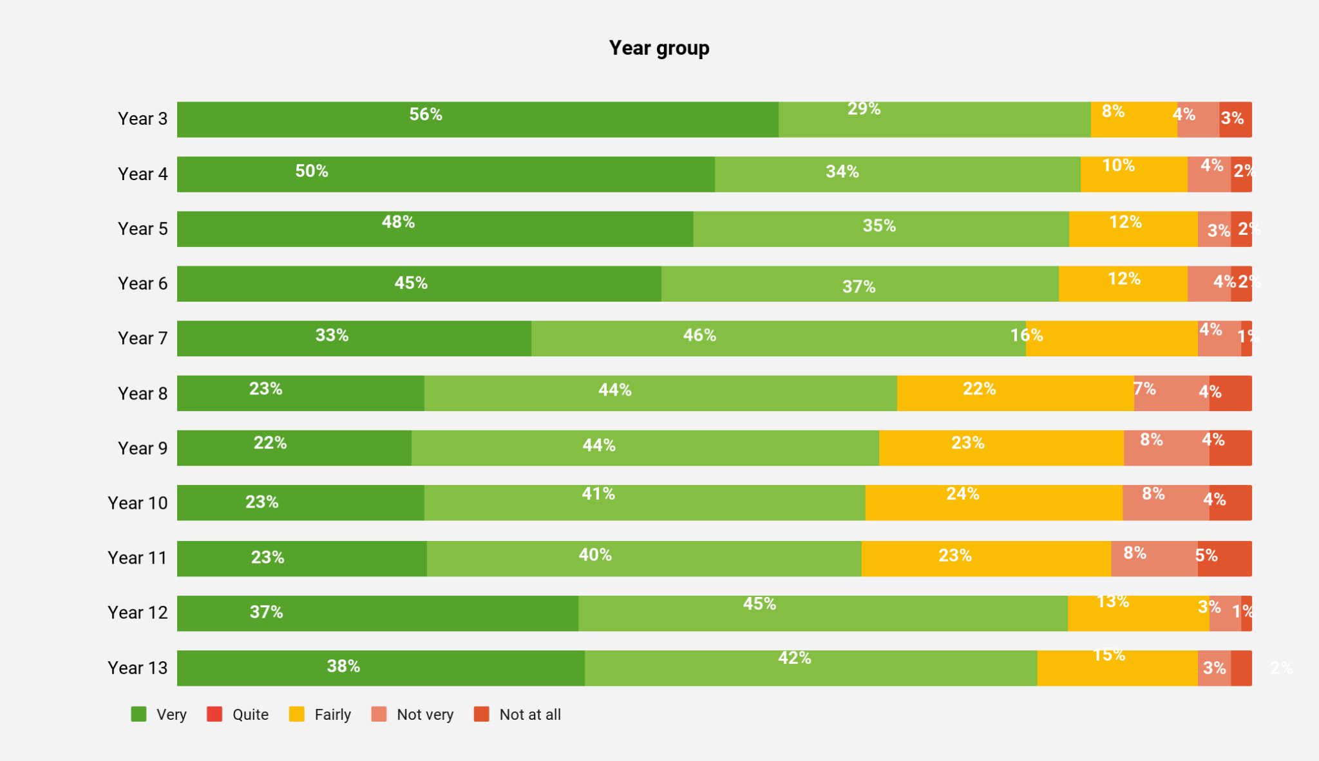
Feelings of safety by year group
Recently (in the last 6 months) how safe have you felt at school?
What it shows:
Feelings of safety in school and out of school drop during years 8 to 11, and rise again in sixth form. Online, feelings of safety generally increase as pupils get older.
Questions to ask yourselves:
What support are we giving to year 6 pupils transitioning to secondary school around how to manage experiences when they don’t feel safe?
How are we adapting our safeguarding support for pupils as they move up the school?
Sample 68,214

Slide 9
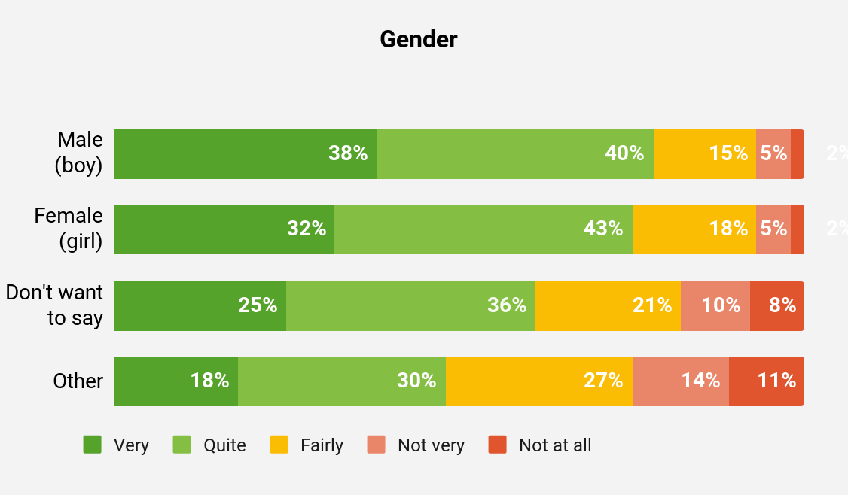
Gender identity and feelings of safety
What it shows:
There are significant differences in feelings of safety at school depending on a pupil’s gender identity: pupils who identify with a gender other than male or female have lower feelings of safety.
Questions to ask yourselves:
How are we ensuring that our schools are inclusive and safe environments for pupils of all genders?
Do we have a trust-wide policy for supporting pupils who don’t identify with a binary gender? If not, would this benefit our settings?
Recently (in the last 6 months) how safe have you felt at school?
Male 27815 - Female 27324 - Don’t want to say 1410 - Other 1285

Slide 10
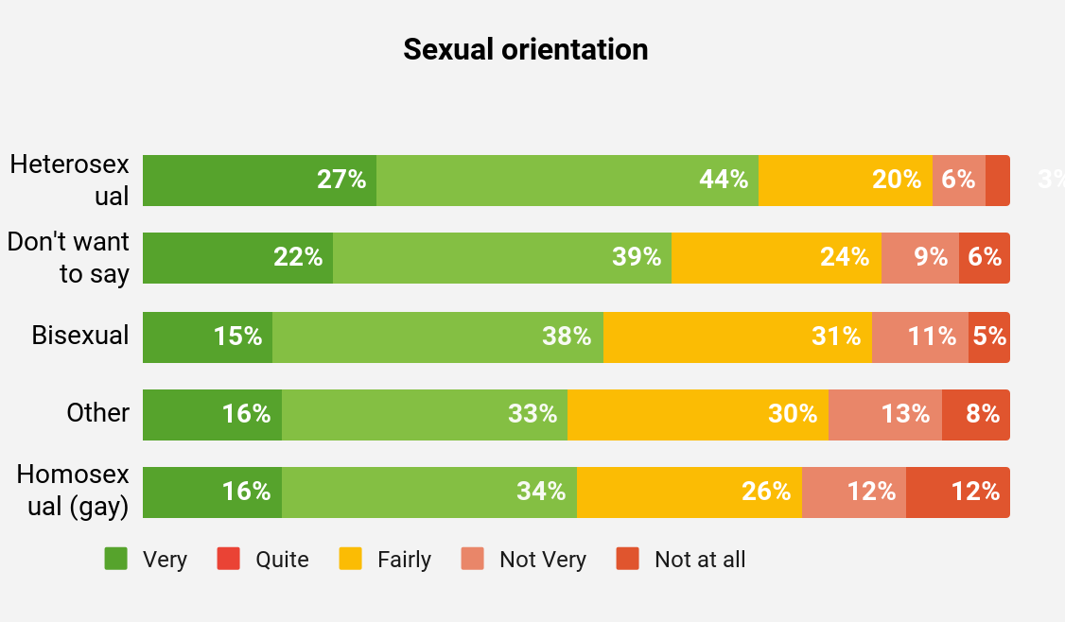
Sexual orientation and feelings of safety
Recently (in the last 6 months) how safe have you felt at school?
What it shows:
Pupils who identify as homosexual or bisexual have lower feelings of safety than pupils who identify as heterosexual.
Questions to ask yourselves:
How are we ensuring that our schools are inclusive and safe environments for pupils of all sexual orientations?
Do we have a trust-wide policy for supporting pupils of all sexual orientations? If not, would this benefit our settings?
Heterosexual 15952 - Don’t want to say 1075 - Bisexual 1608 - Other 969 - Homosexual 840

Slide 11
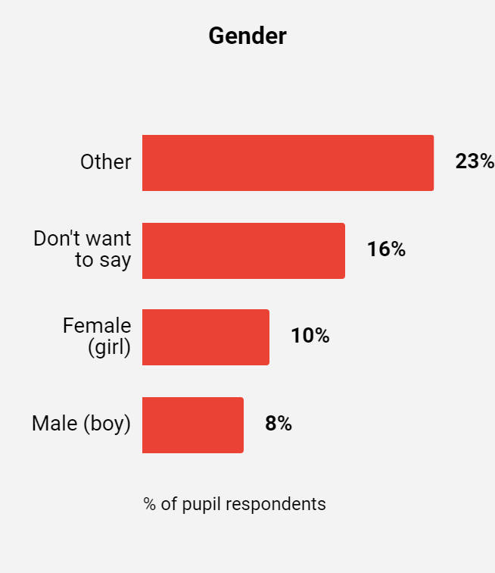
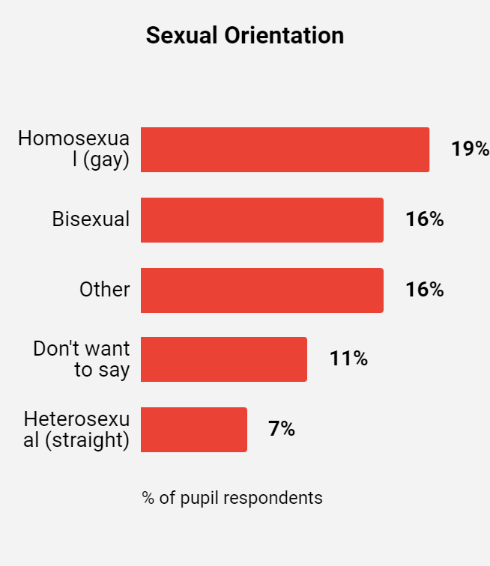
School absence with sexual orientation and gender identity
What it shows:
While 10% of pupils overall have missed school because they’ve felt unsafe, this proportion is far higher for pupils who identify with a gender other than male or female, of whom 23% have missed school.
For pupils who identify as gay, the proportion who’ve missed school because they felt unsafe is 19%, and for pupils identifying as bisexual, this is 16%. This is significantly higher than the overall average for pupils in England (9%).
Question to ask yourselves:
How easy or difficult would it be for our schools to collect data on absence by pupils’ gender identity and sexual orientation?
Do we have anyone in the central team that is looking at this?
Recently (in the last 6 months) have you missed school because you felt unsafe?
Sample 5,269

Slide 12
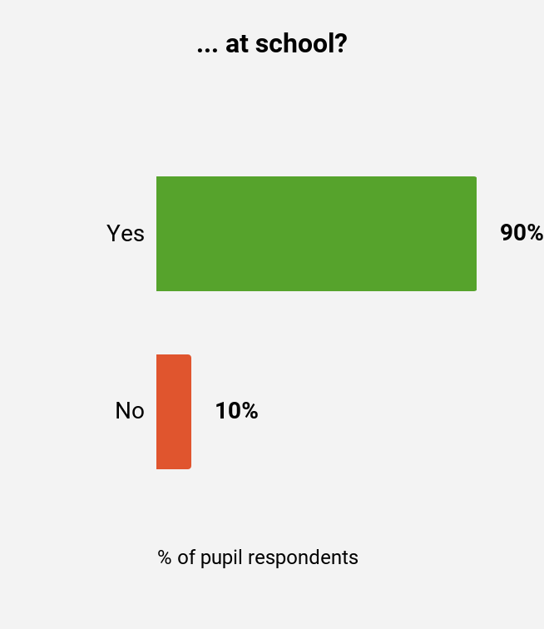
Knowledge of what to do
What it shows:
The majority of pupils feel confident they know what to do if someone makes them feel unsafe at school, out of school or online. However, with around 1 in 10 pupils reporting no in answer to this question, this means around 3 pupils out of a class of 30 don’t know what to do if they feel unsafe.
Questions to ask yourselves:
Do our pupils learn about what to do if someone makes them feel unsafe in all contexts (at school, out of school, online)?
How do our schools check pupils’ understanding, and how frequently do our schools do this?
Do you know what to do if someone makes you feel unsafe…?
Sample 68,214

Slide 13
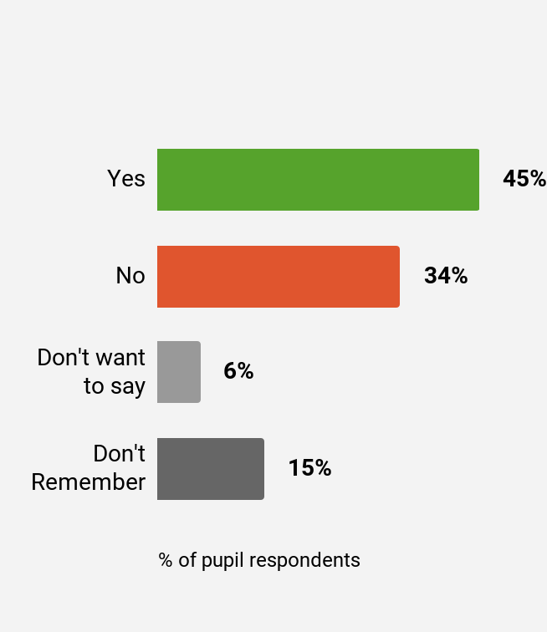
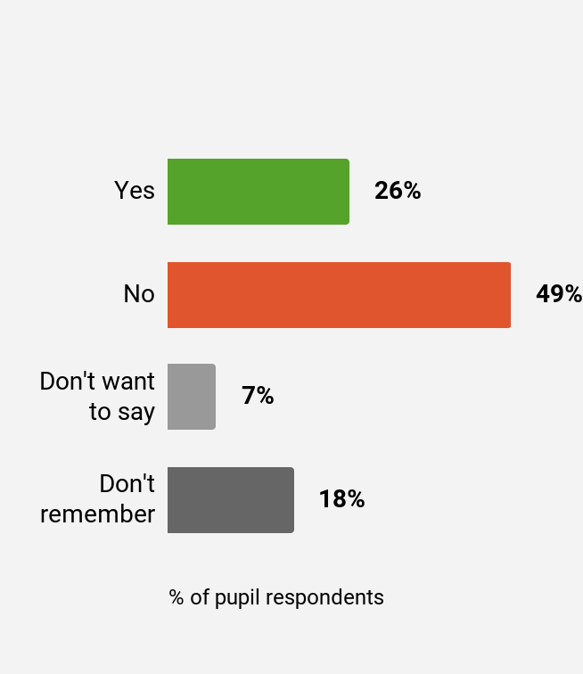
Telling an adult
What it shows:
Only a quarter of those who have felt unsafe reported it to an adult at school. 45% of pupils who felt unsafe told an adult outside of school.
Questions to ask yourselves:
What mechanisms do we have in place to support pupils to report if they feel unsafe?
Are there frequent, diverse opportunities for pupils to report feeling unsafe in school in ways that are confidential and inclusive, and engender a feeling of being “heard”?
When you felt unsafe, did you tell any adults at school about it?
When you felt unsafe, did you tell any adults outside of school about it?
Sample 15,145

Slide 14
Recommended next steps
Recommended next steps
*Available to members of The Key only
Focus area | Steps to take | Resources to help you
Prevent child-on-child abuse | The survey highlights that, most often, it’s other children making pupils feel unsafe at school. There’s no silver bullet to address child-on-child abuse (which includes bullying, physical abuse, sexual abuse, hazing and more) and addressing this issue requires a holistic approach. A robust approach to personal, social and health education (PSHE), embedded throughout the curriculum, is key to making sure your treatment of this issue doesn’t feel ‘tokenistic’ to pupils. Work to develop a culture in your schools that consistently challenges inappropriate behaviour, and encourages pupils to come forward when they see something inappropriate. Regular staff training, as well as well-embedded and easy-to-understand policies, are important tools to help with this. | How to prevent child-on-child abuse How to encourage the reporting of sexism and sexual harassment eLearning: child-on-child abuse Staff briefing: how we can tackle sexism and sexual harassment in our school
Support pupils who are LGBTQ+ | Pupils who are LGBTQ+ are more likely than their peers to report feeling unsafe at school. Creating an inclusive environment where pupils who are LGBTQ+ feel represented and valued will go a long way in making those pupils feel safe in your schools. To be successful, an inclusive approach needs to cover everything from the language you use, what you teach and who you recruit. | Whole-school audit: gender and LGBTQ+ inclusivity Curriculum audit: gender and LGBTQ+ inclusivity Supporting trans pupils: a toolkit
Maintain a focus on online safety | No matter how safe pupils report feeling online, it’s important that online safety remains a focus. Help your schools form strong partnerships with parents and carers around online safety, so they can reinforce online safety teaching at home. These partnerships will also help safeguarding leads pick up on any incidents that pupils report to their parents/carers, rather than to an adult at school. | Online safety: how to review your approach Online safety: involving parents and carers Parent factsheets
Listen to, and act on, pupil voice | Effective safeguarding requires pupil engagement, and for pupils to trust that their views and experiences are important to staff. Schools can build that trust by involving pupils in finding solutions to problems (for example, how to make them feel safer in the corridors) and by acting swiftly. | Pupil voice: guidance, resources and examples Wellbeing: pupil questionnaires Online safety: pupil questionnaires
Think beyond year 7 for transition support | Secondary school pupils report feeling less safe in school as they move out of year 7, when many schools start to withdraw transition support that helped pupils ease into secondary school life. Consider how your schools can continue to support pupils as they move between year groups (as well as into, or out of, the school) and how they can put effective pastoral support in place for pupils in every year group. | Secondary transition: a trauma-informed approach

Slide 15
The Key is the leading support service providing schools and trusts with high-quality guidance that goes further to tackle issues at a deeper level and from all angles. Our Whole School approach gives leaders one trusted source to turn to for any challenge, equipping you with highly-accurate, expertly-synthesised and context-rich resources, guidance and CPD. Because driving lasting change always requires a considered approach.
Our mission to support schools and trusts to get safeguarding right
We know that safeguarding children is a primary concern for school staff, and something we all need to get right. It’s a collective responsibility that’s complex, sensitive and takes so much more than an outstanding designated safeguarding lead. It takes the whole team - and for this, you need comprehensive knowledge and wrap-around support that everyone can lean in to.
That’s why we’re pleased to have partnered with Edurio to get pupils’ perspectives on their feelings of safety - for the first time - which we believe can transform how all of us in the sector look at safeguarding. And as we share the findings of this review, we’re committed to using the insights from pupils themselves to help shape the guidance, support and training schools and trusts need to get safeguarding right for every pupil.
Contact us to learn more about how we can support your school to build a culture of safeguarding. Email us at enquiries@thekeysupport.com.
We’re here to support you
www.thekeysupport.com

