Slide 1
[school name’s]
Safeguarding INSET
2023
This is an extract from the 2023 pack. The full INSET pack for 2024 is available to schools with a Leaders+ Safeguarding or Whole School membership.
Notes:
In advance: adapt the slide notes and the slides where the slide notes say to do so.
On the day: make sure you have a copy of the facilitator notes, either printed or open on a separate device. Have your safeguarding system or form for reporting concerns open, so you can show it to staff during the session and answer questions about it.
[In advance, edit this slide to include your school’s name.]
Welcome staff to your 2023 safeguarding and child protection INSET
Let staff know there’ll be interactivity throughout the session, with videos, quick questions, scenarios and group discussions
Let them know that, as ever with safeguarding, they can take time out at any time, no questions and no judgement
Both Education Support (08000 562 561) and the Samaritans (116 123) offer free and confidential helplines 24/7

Slide 2
Why safeguarding should be everyone’s focus
Today
we’ll learn about…
How we can all act in our pupils’ best interests
The 4 main types of abuse and signs to look out for
Specific safeguarding issues you might see in our school
This is an extract from the 2023 pack. The full INSET pack for 2024 is available to schools with a Leaders+ Safeguarding or Whole School membership.
Notes:
Run through the learning objectives with staff
Acknowledge that some of what you’re covering today might feel familiar, but it’s a key part of what you do as a school

Slide 3

Changes to Keeping Children Safe in Education and what they mean for you…
There haven’t been a lot of changes this year
But there’s a…
  New emphasis on filtering and monitoring systems
  Clearer distinction between children who are absent from education vs. children missing education
This is an extract from the 2023 pack. The full INSET pack for 2024 is available to schools with a Leaders+ Safeguarding or Whole School membership.
Notes:
The slide notes below are an extract from the notes to go with the slide. The full slide notes are only available to schools with a Leaders+ Safeguarding or Whole School membership.
[In advance, decide whether you want your staff who don’t work directly with children to read part 1 of Keeping Children Safe in Education (KCSIE) or the condensed version in Annex A. Update the first bullet point below accordingly.]
Explain that all staff need to read part 1 of Keeping Children Safe in Education OR all staff who work directly with children need to read part 1 of Keeping Children Safe in Education, and staff who don’t work directly with children need to read Annex A of the guidance
The changes to the guidance this year are minimal compared to the last couple of years, but staff still need to be aware of them
You’ll cover the essential information staff need to know from KCSIE part 1 in the rest of this session

Slide 4
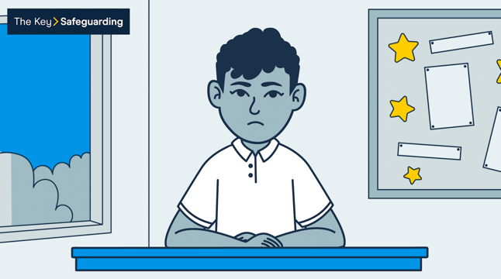


Listen to Charlie’s experience
Video
Video not available in preview
This is an extract from the 2023 pack. The full INSET pack for 2024 is available to schools with a Leaders+ Safeguarding or Whole School membership.
Notes:
The slide notes below are an extract from the notes to go with the slide. The full slide notes are only available to schools with a Leaders+ Safeguarding or Whole School membership.
[Please note: you need to be playing the slideshow to be able to select the link on the slide and play the video.]
Remind staff about the new paragraph in Keeping Children Safe in Education about how children might not know how to, or be ready to, report or even speak about abuse
It’s important staff can respond appropriately if a child does tell them about abuse, so we’re going to spend some time looking at this now. We’re going to start by watching a video where you see a child tell an adult about a harmful experience they’ve had
Note afterwards that the video has been voiced by an actor, but the story is real
Sources:
GOV.UK – DfE, Keeping Children Safe in Education. https://www.gov.uk/government/publications/keeping-children-safe-in-education--2
NSPCC, No one noticed, no one heard. https://learning.nspcc.org.uk/research-resources/2013/no-one-noticed-no-one-heard
NSPCC, Recognising and responding to abuse. https://learning.nspcc.org.uk/child-abuse-and-neglect/recognising-and-responding-to-abuse

Slide 5


Charlie’s experience: what can you remember now?
Practical activity
Time for activity: 3 minutes
What to do: write down what you remember about what Charlie said on page 1 of your activity pack
This is an extract from the 2023 pack. The full INSET pack for 2024 is available to schools with a Leaders+ Safeguarding or Whole School membership.
Notes:
Ask staff to take 3 minutes to write down, individually, what they remember about what Charlie said in the video
There’s space for them to do this on page 1 of their activity packs

Slide 6


Cost-of-living crisis: what impact is it having on our pupils?
Mental health
Quality of life
Loneliness
School life
Home life
Crime
This is an extract from the 2023 pack. The full INSET pack for 2024 is available to schools with a Leaders+ Safeguarding or Whole School membership.
Notes:
The slide notes below are an extract from the notes to go with the slide. The full slide notes are only available to schools with a Leaders+ Safeguarding or Whole School membership.
Explain to staff that the cost-of-living crisis is something that they may not have considered before in terms of safeguarding – but as you’ve discussed earlier when looking at neglect, it’s something that everyone needs to be aware of
Remind staff that poverty is not the same as neglect, and you are not suggesting that any pupil affected by the cost-of-living crisis is being neglected or otherwise abused – however, it does increase the risk of various safeguarding issues, which we’re going to go through now
Sources:
Action for Children, How is the cost of living crisis impacting children? https://www.actionforchildren.org.uk/blog/how-is-the-cost-of-living-crisis-impacting-children/
Barnardos, At what cost? The impact of the cost-of-living on children and young people. https://www.barnardos.org.uk/get-involved/campaign-with-us/impact-of-cost-of-living
BBC Children in Need, “I can’t afford it” – how poverty can lead to exclusion and isolation. https://www.bbcchildreninneed.co.uk/changing-lives/our-latest-on-the-cost-of-living-crisis/i-cant-afford-it-how-poverty-can-lead-to-exclusion-and-isolation/
BBC Children in Need, Our latest on the cost of living crisis. https://www.bbcchildreninneed.co.uk/changing-lives/our-latest-on-the-cost-of-living-crisis/
The Children’s Society, Children in a cost of living crisis. https://www.childrenssociety.org.uk/what-we-do/blogs/children-cost-of-living-crisis
The Children’s Society, Criminals capitalising on a crisis. https://www.childrenssociety.org.uk/what-we-do/blogs/criminals-capitalising-cost-living-crisis
Women’s Aid, The cost of living is preventing women from fleeing domestic abuse. https://www.womensaid.org.uk/the-cost-of-living/
Young Minds, Money and mental health. https://www.youngminds.org.uk/parent/parents-a-z-mental-health-guide/money-and-mental-health/

Slide 7

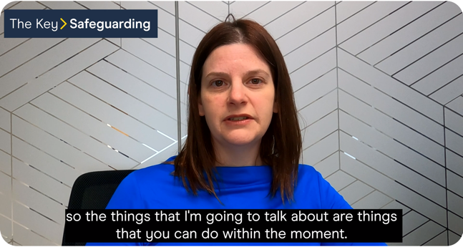

Mental health: you can’t diagnose but you can spot signs
Safeguarding issue 6: mental health
Video
Video not available in preview
This is an extract from the 2023 pack. The full INSET pack for 2024 is available to schools with a Leaders+ Safeguarding or Whole School membership.
Notes:
The slide notes below are an extract from the notes to go with the slide. The full slide notes are only available to schools with a Leaders+ Safeguarding or Whole School membership.
[If you want to cover mental health, decide whether you want to show the video in this slide (more in depth), or talk through the next slide (less in depth). Delete this slide if you’re not using the video at your safeguarding INSET. Please note: you need to be playing the slideshow to be able to select the link on the slide and play the video. In advance, prepare to remind staff of your procedures for reporting concerns about pupils’ mental health.
This video starts with a story about how poor mental health can affect children and gives some context to the issue. It then covers what staff should look out for, and finishes with an expert talking about what school staff can do.]
Remind staff that mental health is part of safeguarding
Explain that mental health needs can be an indicator of suffering abuse, neglect or exploitation, or that a child is at risk – remind them about the earlier slide where you saw that children with mental health needs are more vulnerable
Sources:
The Children’s Society, Children’s mental health statistics. https://www.childrenssociety.org.uk/what-we-do/our-work/well-being/mental-health-statistics
GOV.UK – Department for Education, Keeping Children Safe in Education. https://www.gov.uk/government/publications/keeping-children-safe-in-education--2
The Guardian, Swamped NHS mental health services turning away children, say GPs. https://www.theguardian.com/society/2022/apr/03/swamped-nhs-mental-health-services-turning-away-children-say-doctors
NHS, Depression in children and young people. https://www.nhs.uk/mental-health/children-and-young-adults/advice-for-parents/children-depressed-signs/
NSPCC, Depression, anxiety and mental health. https://www.nspcc.org.uk/keeping-children-safe/childrens-mental-health/depression-anxiety-mental-health/
NSPCC, No one noticed, no one heard. https://learning.nspcc.org.uk/research-resources/2013/no-one-noticed-no-one-heard

Slide 8


Key takeaways from today’s training
Always assume ‘it could happen here’ and be professionally curious
Always act in the child’s best interests, including alleged perpetrators
Be on the lookout for signs of abuse, and in particular, for changes in a child
If you see something, say something – including concerns about staff and our safeguarding practice
Always make a written record too
This is an extract from the 2023 pack. The full INSET pack for 2024 is available to schools with a Leaders+ Safeguarding or Whole School membership.
Notes:
The slide notes below are an extract from the notes to go with the slide. The full slide notes are only available to schools with a Leaders+ Safeguarding or Whole School membership.
Tell staff that you’ve now reached the end of today’s safeguarding INSET
Round off by recapping the key messages from this training session

Slide 9
This is an extract from the 2023 pack. The full INSET pack for 2024 is available to schools with a Leaders+ Safeguarding or Whole School membership.
View membership pricing at https://key.sc/INSET2024

